Slide 1
DEEP ENERGY EFFICIENCY RETROFITS VERSUS DIRECT ELECTRIFICATION FOR URGENT EMISSIONS REDUCTION: A CASE STUDY USING 33,780 RESIDENTIAL ENERGY PROFILES IN WATERLOO, CANADA
Heather McDiarmid¹, Paul Parker²
1 Research Associate, hmcdiarm@uwaterloo.ca and
2 Professor, pparker@uwaterloo.ca
13th International Green Energy Conference IGEC-XIII
Paper ID 242, Session #S15

Slide 2
Background
Buildings = 40% of global greenhouse gas (GHG) emissions, 2018
To keep global average temperature increase to less than 1.5-2.0°C
emissions must fall by 25-45% by 2030
reach net zero by 2050-2070 (IPCC, 2018).
In advanced economies, most buildings that will exist in 2050 have already been built.
Challenge:
What is the best way to cut GHG emissions from existing buildings?

Slide 3
Conventional wisdom for existing buildings
Reduce the total energy needs of buildings through retrofits
Decarbonize the electricity supply
Electrify all building operations
Heat pumps can supply all space and water heating needs using a fraction of the energy of conventional systems.

Slide 4
Historical residential retrofit activity in Waterloo Region
Even with incentives, retrofit activity peaked at 1.6% of homes/year.

Slide 5
Convincing homeowners to invest in deep energy efficiency retrofits has been difficult
High upfront costs
Long payback periods
Low energy literacy
Imperfect information
Low awareness of non-energy benefits of retrofits
Competing priorities
Availability of trusted tradespeople
Hassles and disruptions of renovations
Split incentives
….

Slide 6
A proposed shift in focus
In geographies where the electricity supply is already largely decarbonized:
Shift the priority for most homes to direct electrification
Use policies to ensure equipment is replaced with highly efficient electric alternatives when they reach their end of useful life
Requires no additional homeowner effort
Focus the retrofit efforts on
the least energy efficient homes and
homes at risk of energy poverty

Slide 7
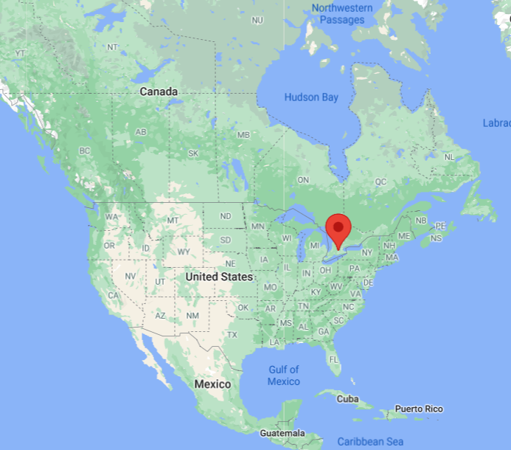
Waterloo Region case study
33,780 EnerGuide for Houses (EGH) home energy audit data 1998-2020
Population of 620,000
Daily average temperature -10 to 26°C
Electricity supply was over 90% decarbonized in 2016

Slide 8
Average Waterloo home energy profiles before and after retrofits and the potential with deep retrofits

Slide 9
Average heating system efficiency before and after retrofits, and the potential with heat pumps

Slide 10
Average Waterloo Region residential annual energy use after retrofits or direct electrification.

Slide 11
Average Waterloo Region residential annual GHGe after retrofits or direct electrification

Slide 12
Electricity grid implications of direct electrification
Direct electrification
Increases overall electricity demand
Increases peak demand on cold days
Shifts peak demand from summer (AC) to winter (heating)
Yet,
Between 1950 and 1975, Canada doubled its electricity supply every decade
The electricity supply must grow and modernize to accommodate
Electrified transportation and industrial processes
Decentralized generation and storage
The extra grid demands resulting from direct electrification of buildings should be a motivator to address shortcomings in the electricity supply and grid infrastructure, not an excuse to avoid the adoption of low carbon technologies.

Slide 13
Policies for direct electrification
Regulate the minimum performance standards for heating systems
Canadian government has an aspirational goal of
All water heaters sold >100% efficient by 2030
All space heaters sold >100% efficient by 2035
California’s Building Decarbonization Coalition proposed
100% of all space heaters are heat pumps by 2030
Many US communities have banned the hookup of natural gas in new buildings

Slide 14
Conclusions
Only a few decades left to completely decarbonize the building sector
The retrofit first strategy has seen low homeowner adoption due to multiple barriers
Policies to require the use of electric heat pumps when replacing aging space and water heaters are an easier and faster approach to reducing emissions from buildings
Retrofit efforts should focus on the least energy efficient homes and homes at risk of energy poverty

